Slide 1


INVESTMENT ANALYSIS
$440,000
ASSET PROPOSAL
REDWOOD BEACH RESORT
EXTRAORDINARY PRIVATE BEACHFRONT INVESTMENT
LAND AREA
UTILITY ACCESS
LEGAL STATUS
2.5 Manzanas
PRIVATE WELLS /TRANSFORMER
TITLED, BEACHFRONT PROPERTY
PRICE: $440,000
RARE INVESTMENT OPPORTUNITY
CORPORATE OWNED W/ALL LICENSES
RELOCATABLE UTILITIES
Note: Surrounding property owned by Stacy Juliane Sabo. Electrical units can be relocated behind cabanas.
ISSUE DATE
MARKET STATUS
2026.06.25
Re/Max, Pedro Resau
CONFIDENTIAL - INVESTORS ONLY

Slide 2
ASSET_INDEX // $440,000 // 2.5 MANZANAS
PROJECT ROADMAP
01 / SECTION. Page 3
04 / SECTION. Page 8
PROPERTY OVERVIEW
SOCIAL MEDIA & OTAs
02 / SECTION. Page 4
05 / SECTION. Page 9 - 11
TOPOGRAPHY
COMPARATIVE MARKET ANALYSES
03 / SECTION. Page 5 - 6
06 / SECTION. Page 12
INFRASTRUCTURE & FACILITIES
MONTHLY EXPENSES
07/ SECTION. Page 7
08 / SECTION. Page 13
LAND & ADDITIONAL FEATURES
BOTTOM LINE

Slide 3





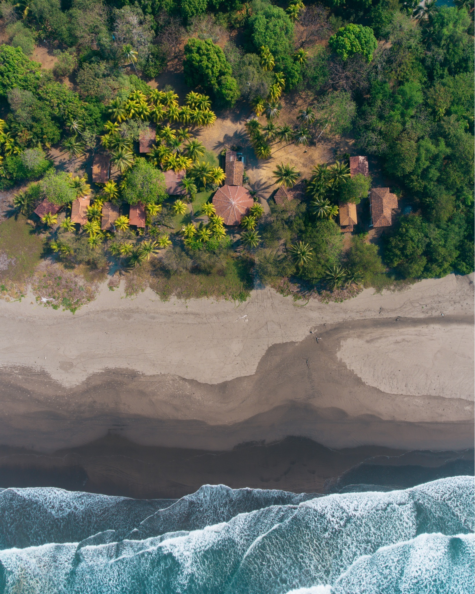
PROPERTY OVERVIEW
Exceptional Scale & Access
2.5 Manzanas
Boasting a rare 239.58 meters of direct oceanfront on the Pacific Ocean, offering unparalleled privacy and development breadth.
Prime Beachfront Location
Spanning 2.5 manzanas in Mechapa. Renowned for world-class surfing and fishing, adjacent to Estero Padre Ramos Nature Reserve and at the base of Volcano Cosiguina.
Oceanfront Private Estate
EXCLUSIVE $440,000 OPPORTUNITY
Turnkey Infrastructure
A fully operational estate priced at $440,000. Includes furnished cabanas, a restaurant, Tiki Bar, two 2-story brick residences with a private brick garage, and a buildable lot of approx. 1 manzana.
Advantage of Renovating
The existing INTUR-registered oceanfront cabanas are grandfathered under current building regulations, allowing extensive renovations while preserving a beachfront footprint that would not be permitted for new construction today.

Slide 4

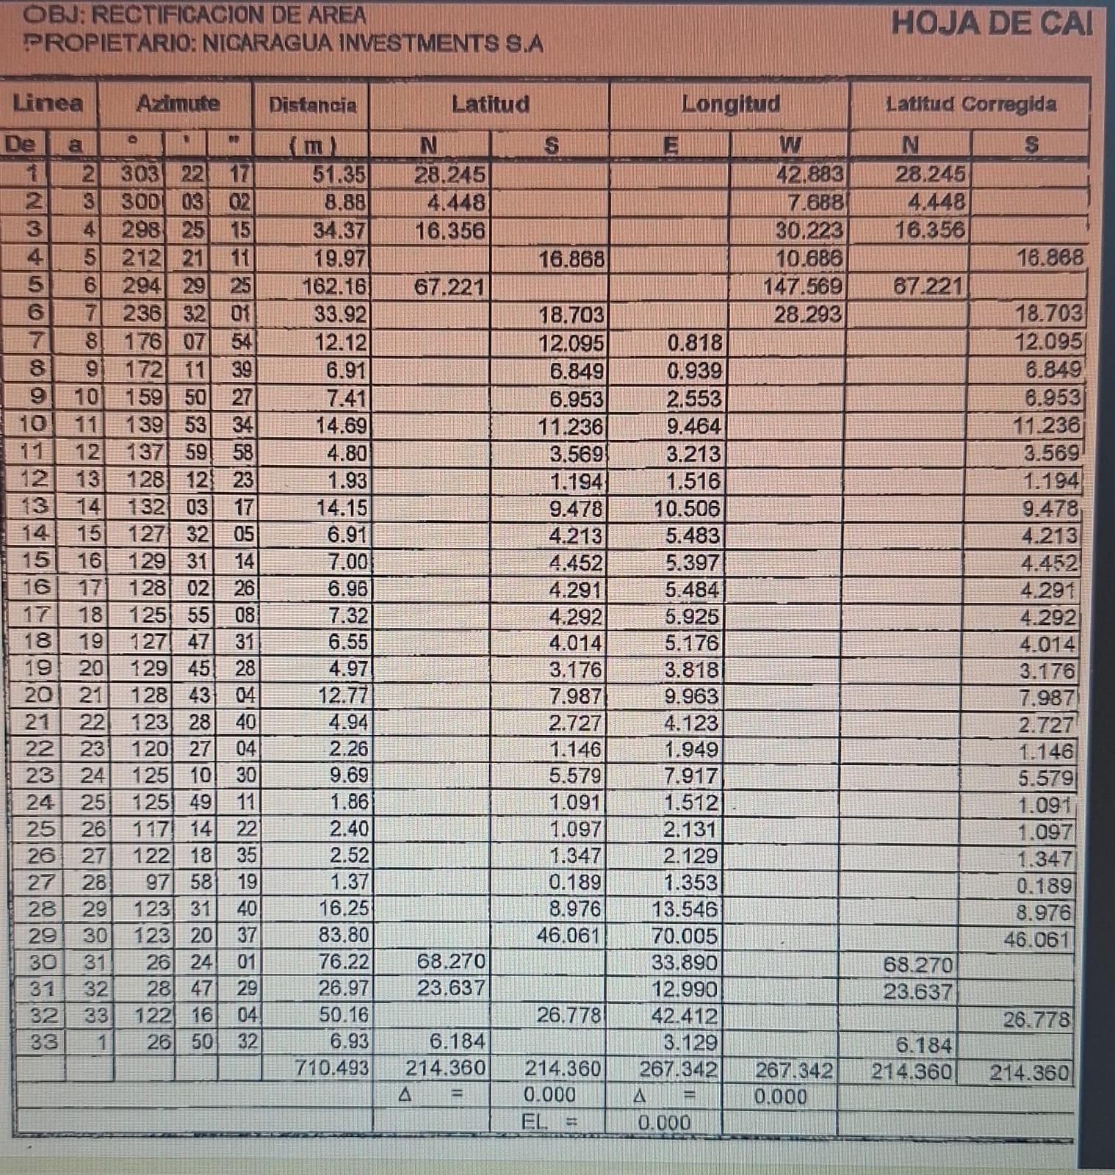
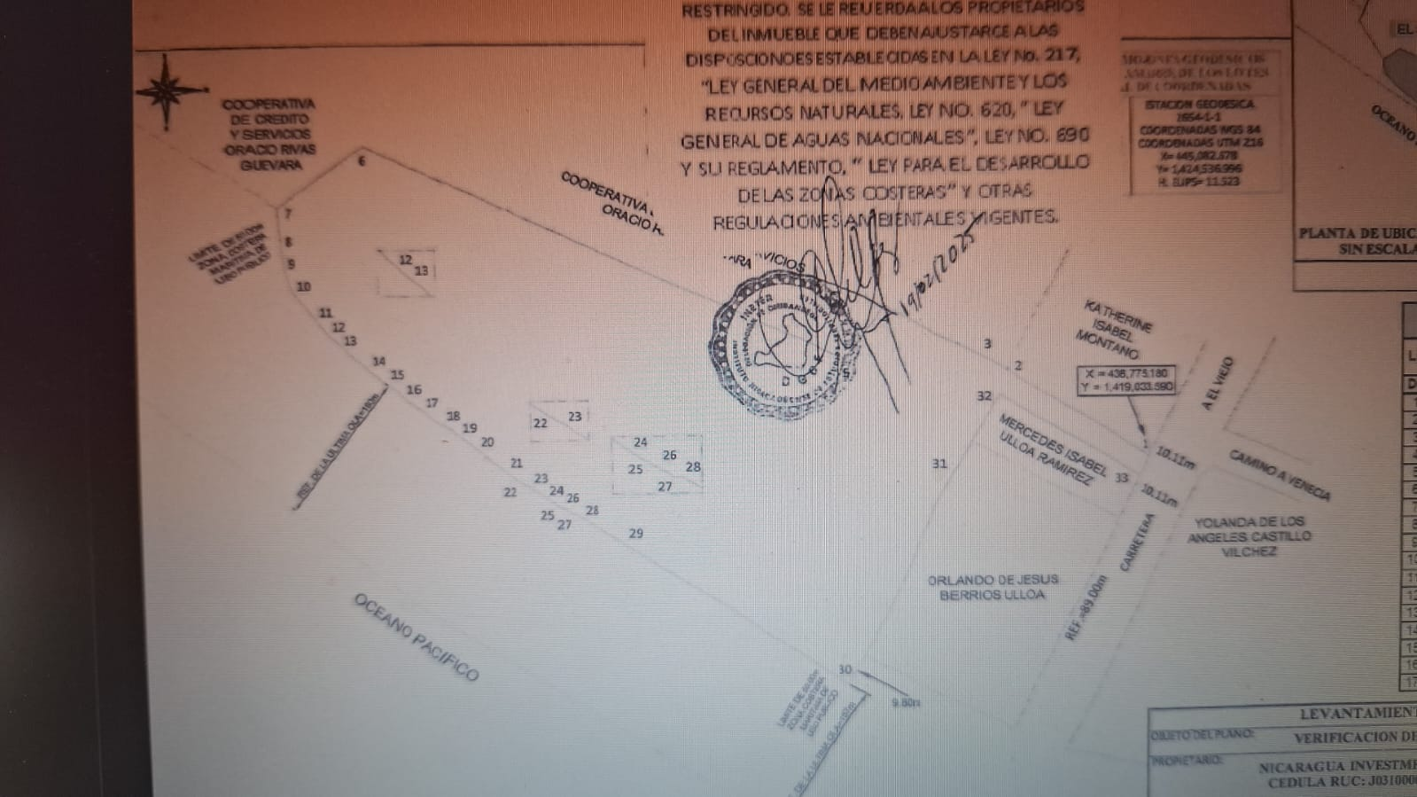
LAND & TOPOGRAPHY ANALYSIS
PROPERTY OVERVIEW
Boundary Plan (Post-Cabana 4)
Topographical Survey Detail
Exclusive 2.5 manzana oceanfront lot. The property line officially concludes after Cabana 4, providing an optimized layout for luxury development. Connected electricity to Union Fenosa. Maximum development flexibility.
2.5 mz
TOTAL AREA

Slide 5





Oceanfront Cabanas
Four 1-bedroom units (300 sq ft each) with A/C, private baths, and direct ocean access.
7+Units
Grand Two-Story Cabana
A spacious 2-bedroom unit with a large balcony, full kitchen, and an open-air entertainment area with a bar and pool table.
Accommodation Facilities
Brick Residences
Two distinct two-story brick homes (Main House & Loft) offering multiple bedrooms, full amenities, private electric door garage and private ocean-facing balconies.
Comfortable oceanfront residences designed for a premium private estate experience.
Guest Amenities & Support
Includes an open-air Tiki Bar and a dedicated office building. Note that the laundry/electrical room can remain on the back 7 mzs and the land can be leased OR be relocated to space behind the cabanas.

Slide 6




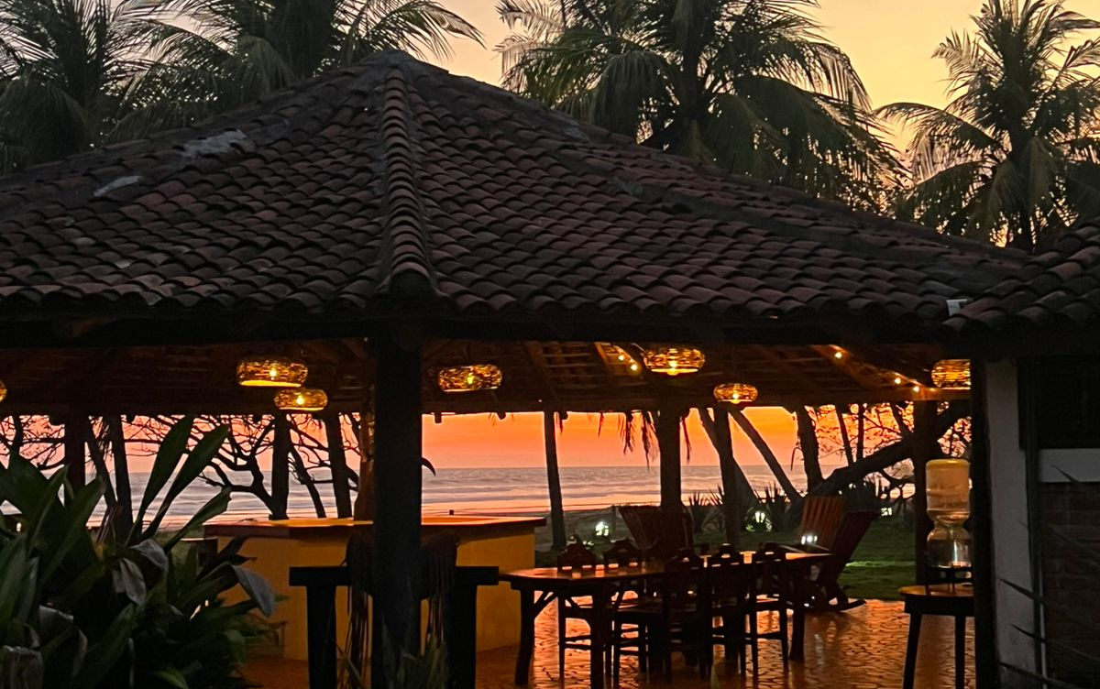



Dining & Infrastructure
Self-Sufficient Operations for the 2.5 Manzana Estate
Dining & Social
Professional Kitchen
23-seat restaurant, two cocktail lounges, and a traditional teja-roofed rancho.
Viking stove, large BBQ, and commercial refrigeration for 25+ guests.
Power Utility
Essential Services
Private transformer located off the main road with 1 generator for kitchen/private residences and dual 12,000W backup generators in the electrical house currently located on the 7 mzs.
Private well (2500L storage) with filer and pressure pump. High-speed internet tower and IBW contract. Potential for Starlink connection (currently in the Owners House on the 7mzs.)
$440K
TOTAL ASKING
INVESTMENT
Relocation Note: The existing laundry and electrical room can be leased or relocated to the ample space available behind the cabanas to optimize layout.

Slide 7





Land and Additional Features
Land Potential
Features a buildable lot of approximately 1 manzana located closest to the village, ideal for expansion or additional structures. Existing units are turn-key ready.
Ownership
2.5MANZANAS
A “unicorn”: This property is completely titled with the Nicaraguan government and has all tax documents dating back to 2006. NO CONCESSION.
An exclusive beachfront lot with significant development potential.
Stable Infrastructure
Redwood Beach Resort features established, reliable infrastructure that supports seamless daily operations. The property is fully functional and ready for immediate use without significant capital improvements.
Ecological Proximity
Located within the Estero Padre Ramos Nature Reserve, a key ecological site renowned for world-class surfing and fishing. Driving distance to Volcano Cosiguina and the Gulf of Fonseca.

Slide 8






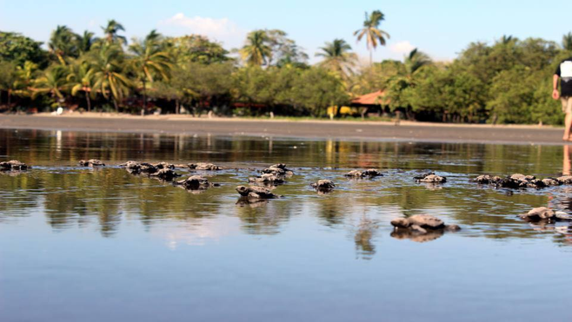
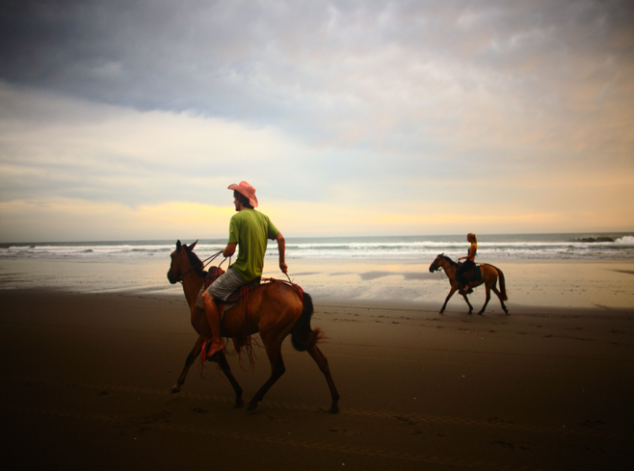
Social Media/OTA’s
Facebook
Instagram
X
Website
Redwood Beach Resort is actively listed on all major OTA’s and has received TripAdvisor’s People’s Choice Award for years 2010-2017 and 2025.
Aerial Video Tour
Experience Redwood Beach Estate from above. View our full aerial drone tour at:
YOUTUBE
Aerial Surf Video
The hottest surf and vacation location in Central America. View the Instagram video at:
INSTAGRAM

Slide 9
Comparative Market Analysis
Benchmarked against comparable Pacific beachfront listings in Nicaragua
PROPERTY | LOCATION | ASKING PRICE | LAND AREA
Redwood Beach Resort | Mechapa, Chinandega | $440,000 | 2.5 mz · 4.3 ac
Jake's on the Beach | Las Peñitas, León | $449,000 | 749 m²
Hotel Alcazar | San Juan del Sur | $990,000 | 577 m²
Beachfront Hostel | Popoyo, Rivas | $555,000 | 2,700 m²
Hostel & Restaurant | Playa Guasacate | $230,000 | 872 m²
Tierra Nahua Eco Lodge | Popoyo, Rivas | $320,000 | 1,043 m²
ASKING PRICE PER M² (USD)
Lower is stronger land value
Redwood
$25
Popoyo Hostel
$206
Guasacate
$264
Tierra Nahua
$307
Jake's
$600
Alcazar
$1,716
Best value per square meter: At roughly $25/m², Redwood offers the largest titled oceanfront parcel — 2.5 manzanas — at the lowest land cost among comparable listings, which range from about $200 to $1,700/m².
Source: Public broker listings (RE/MAX Nicaragua, Trinity Real Estate, NicaRealtors, Life in Nica), 2025–2026. Price per m² derived from asking price ÷ land area; figures are approximate.

Slide 10
Comparative Market Analysis
Recent private purchases along the Beaches of Mechapa & Venecia (27 km of Pacific coastline)
OWNER | LOCATION | LOT SIZE | PURCHASE (YEAR) | OWNER UPGRADES | TOTAL INVESTED
John | Cocoparadiso, Mechapa | 2 mz | $150,000 (2022) | ≈ $175K — water, power, security, WiFi, kitchen, 2 units | ≈ $325K
M. | Four Palms, Mechapa | ½ mz | $100,000 (2021) | $275K — house, entranceway, landscaping | $375K
W. | Four Palms, Mechapa | ½ mz · inland | $150,000 | — raw inland lot, no utilities yet | $150K
Echos Surf Camp | Venecia (the point) | ≈ 2 mz · oceanfront | $325,000 (2025) | ≈ $100K+ — rancho kitchen & social area, 2 units, rainwater tanks | ≈ $425K
TOTAL INVESTED PER PROPERTY (USD)
Purchase price + owner capital upgrades · sorted by total commitment
W.
$150K
John
$325K
M.
$375K
Echos Surf Camp
$425K
All concession, not titled: Unlike Redwood Beach Resort's titled parcel, all four are government concession (leased) land, not titled — yet between 2021 and 2025 private buyers still paid growing sums and reinvested heavily along the 27 km of beach at Mechapa and Venecia, pushing total commitments from $150,000 toward $425,000 per property and signaling strong, accelerating interest in the area.
Source: Direct local knowledge of private, off-market transactions — no public listing data available. Echos Surf Camp was formerly Jeanine & Slim's house. Purchase years and upgrade figures are owner-reported estimates and approximate.

Slide 11
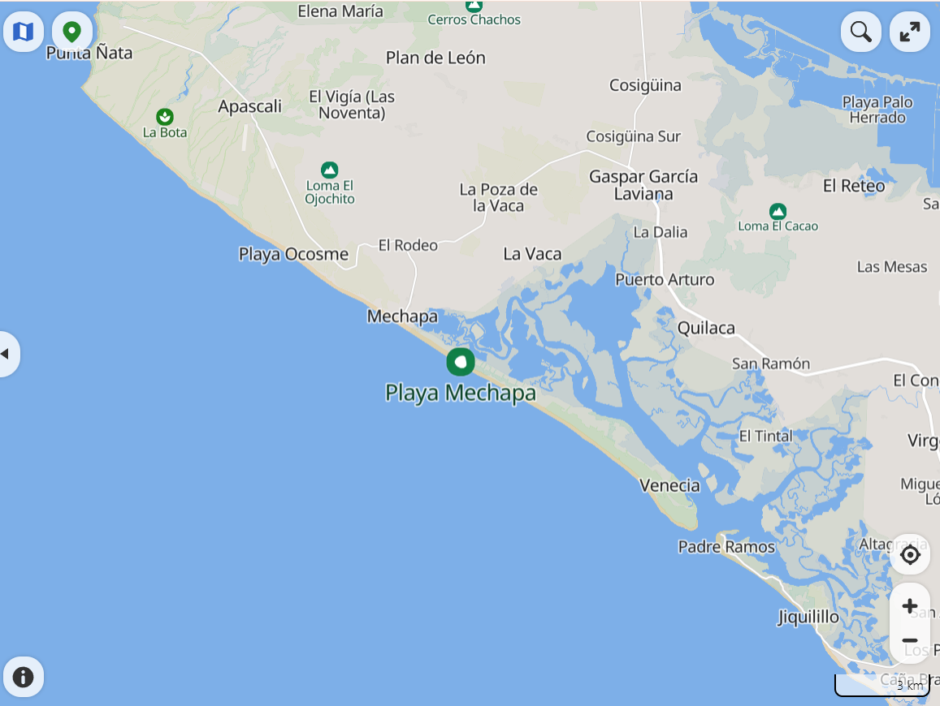
Property Locations
Where the four recent private purchases sit along the Beaches of Mechapa & Venecia (27 km of Pacific coastline)
RBR
THE FOUR PRIVATE PURCHASES
John & Leah
Cocoparadiso, Mechapa
Mike P.
Four Palms, Venecia
RBR
Warren
Four Palms, Venecia · inland
Echos Surf Camp
Venecia (the point) · oceanfront
All concession, not titled. All four sit along the same 27 km stretch of beach at Mechapa and Venecia — and all are government concession (leased) land, unlike Redwood Beach Resort's titled parcel.
The Beaches of Mechapa & Venecia — 27 km of Pacific coastline

Slide 12
Current Monthly Expenses
Estimated operating costs to carry the turnkey 2.5-manzana estate
EXPENSE CATEGORY | MONTHLY (USD)
Staff & Payroll | $1,200
Electricity (transformer + generators) | $450
Maintenance & Grounds | $400
Security – Ring Cameras | $5
Legal/Accounting | $150
Supplies & Miscellaneous | $200
Internet, Hotelrunner | $160
Property Tax (IBI, prorated) | $12
TOTAL ESTIMATED | $2,577
$2,577
PER MONTH · APPROX. $31,000 / YEAR
Lean carrying costs reflect low local wages, on-site wells, and a private transformer. The estate runs self-sufficiently with a small caretaker team, leaving ample margin once rental income is online.
Illustrative estimates for planning only — actual operating costs vary with occupancy and season. Replace with verified figures before due diligence.

Slide 13


Bottom Line…
Private Beachfront w/village access
Hotel Revenue + Private Estate
Experience the serene expanse of our Pacific beachfront, where tranquility meets the shore. The unique advantage of being located in a small fishing village and within walking distance to fresh fish and shrimp, vegetable markets, propane, fuel, etc.
Five charming cabanas designed for a deep connection with the sea within the estate. A separate, potential “Owner’s Complex”, two 2-story brick residences with separate garage provides privacy and distance from rentable units.
More than an investment—
it is a legacy property with unlimited potential.
A Truly Irreplaceable Beachfront Location
Redwood Beach Resort occupies what many consider the "sweet spot" along Mechapa's spectacular 27-kilometer Pacific coastline—a location that combines accessibility, reliable infrastructure, and exceptional long-term development potential.
To the north, the dramatic Farallones cliffs create a stunning natural backdrop but present significant barriers to development, including difficult terrain, limited potable water, no road access, and seasonal isolation during the rainy season when the nearby river becomes impassable from the beach.
Within the town of Mechapa, beachfront opportunities are increasingly limited as residential expansion continues to reduce the availability of prime oceanfront property.
Just 3 kilometers south lies the Estero Padre Ramos Nature Reserve and the Venecia Peninsula. While breathtakingly beautiful, new construction in this protected area typically requires additional land and environmental permitting, freshwater resources are limited, and access to employees, supplies, and services is considerably less convenient.
By contrast, Redwood Beach Resort offers a rare combination of established infrastructure, dependable utilities, year-round accessibility, and over two decades of proven resilience to the region's most severe weather events. For an investor, this translates into something invaluable: confidence that your investment is built on one of the most practical, sustainable, and difficult-to-replicate beachfront locations on Nicaragua's Pacific coast.

